Slide 1


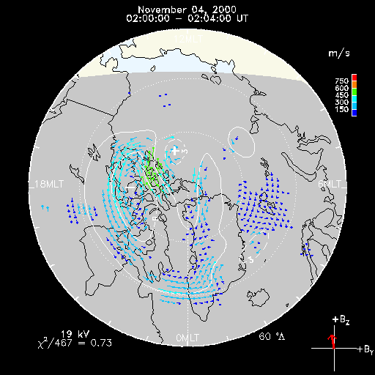
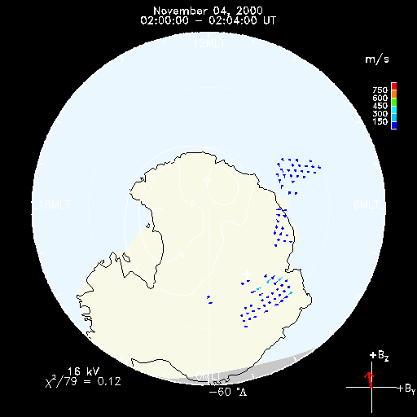
Map_Potential 2.0?
E. D. P. Cousins, S. G. Shepherd
North
South
SuperDARN Workshop, 2011

Slide 2
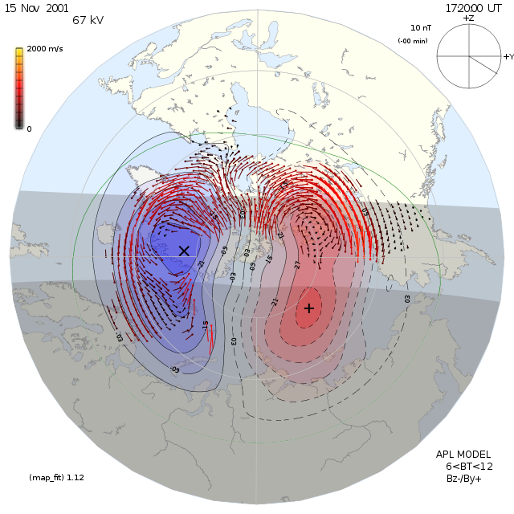
Map_Potential Procedure
Find Heppner Maynard boundary
Get IMF values
Add statistical model vectors
Do spherical harmonic fit (SHF)

Slide 3
Map_Potential Procedure
Find Heppner Maynard boundary
Get IMF values
Add statistical model vectors
Do spherical harmonic fit (SHF)

Slide 4
Map_Potential Procedure
Find Heppner Maynard boundary
Get IMF values
Add statistical model vectors
Do spherical harmonic fit (SHF)

Slide 5
Map_Potential Procedure
Find Heppner Maynard boundary
Get IMF values
Add statistical model vectors
Do spherical harmonic fit (SHF)

Slide 6
Updates
Magnetic Field Model
  Dipole → IGRF
  Changes model vector calculation and SHF procedure
Statistical model data error weighting
  Uniform → Variable
  Changes SHF procedure
Statistical Model
  RG96 → CS10 [Cousins and Shepherd, JGR, 2010]
  Changes model vector calculation

Slide 7
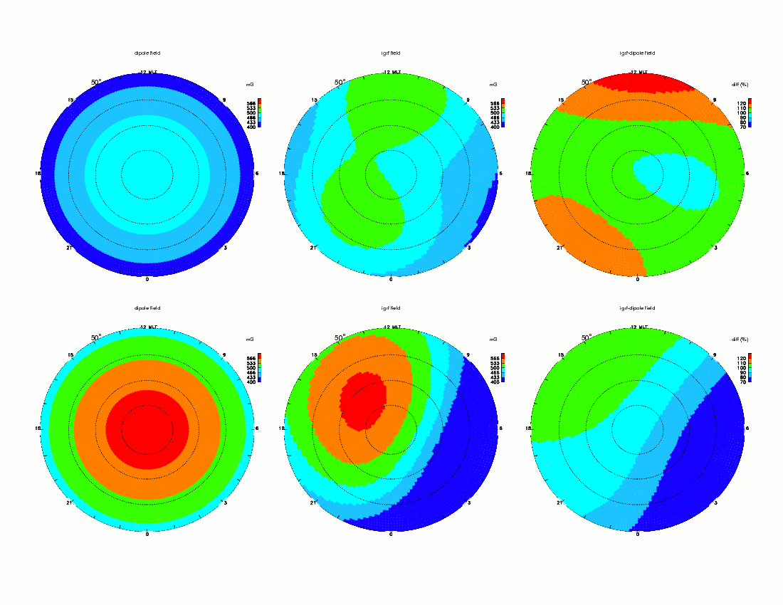
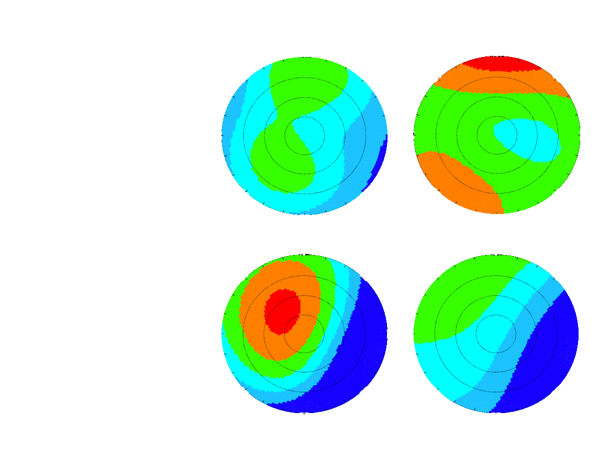
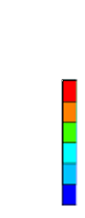
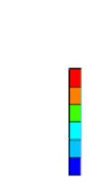

Magnetic Field Model
Dipole field
IGRF field
Difference
50°
North
$$V=\frac{E×B}{B^{2}}→\frac{E}{B}$$
-50°
South

Slide 8
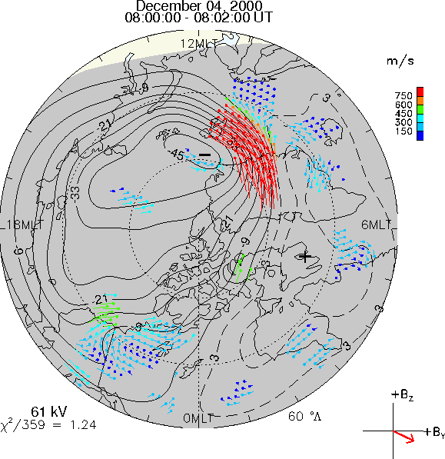
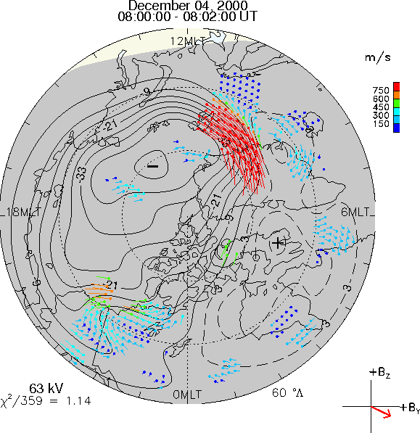
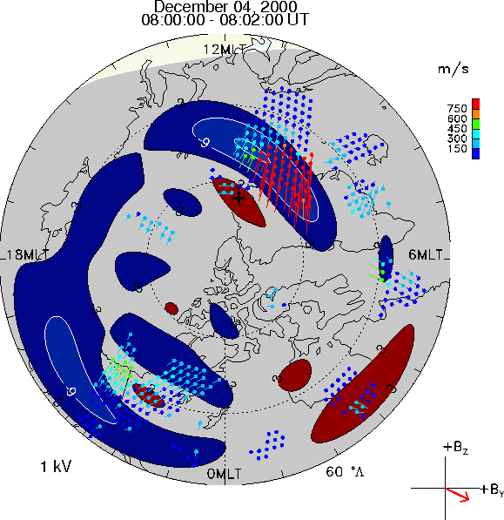
Magnetic Field Model
Dipole
North
December 04, 2000
08:00 – 08:02 UT
IGRF
Difference
63 kV
χ²/359=1.14
Over 72 hours:
Average Φ_{PC} Diff = 2%
RMS Diff = 2 kV
2%

Slide 9
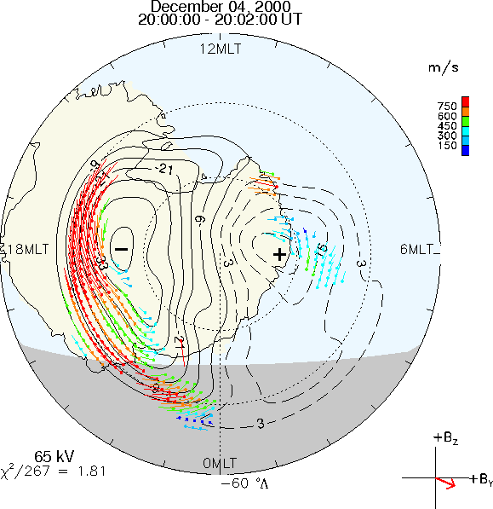
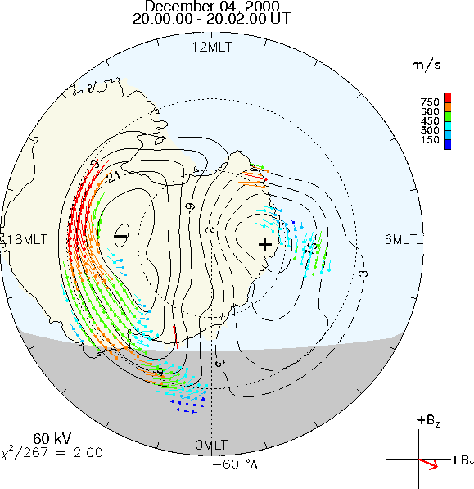
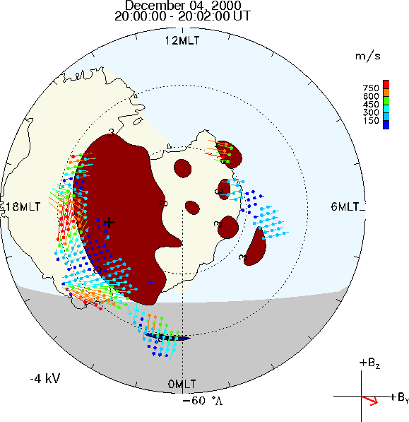
Magnetic Field Model
Dipole
South
December 04, 2000
08:00 – 08:02 UT
IGRF
Difference
60 kV
χ²/267=2.00
Over 72 hours:
Average Φ_{PC} Diff = -4.5%
RMS Diff = 1.6 kV
-6%

Slide 10
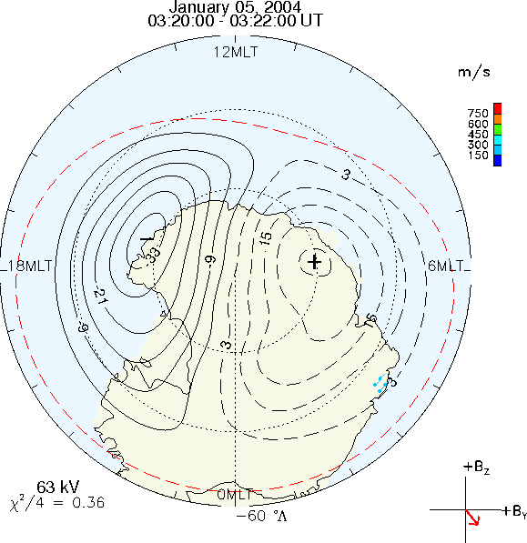
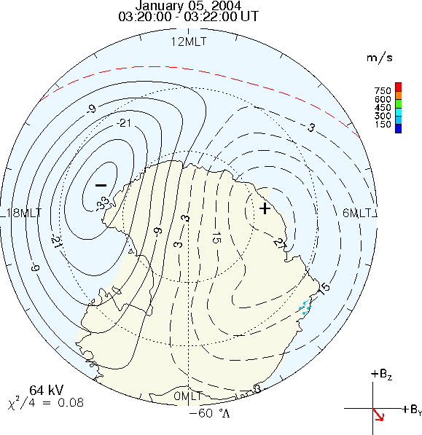
Heppner Maynard Boundary
Original
South
January 05, 2004
03:20:00 – 03:20:22 UT
No default HMB latitude
With no data: Original procedure sets HMB = 62°
New procedure uses model lower limit

Slide 11
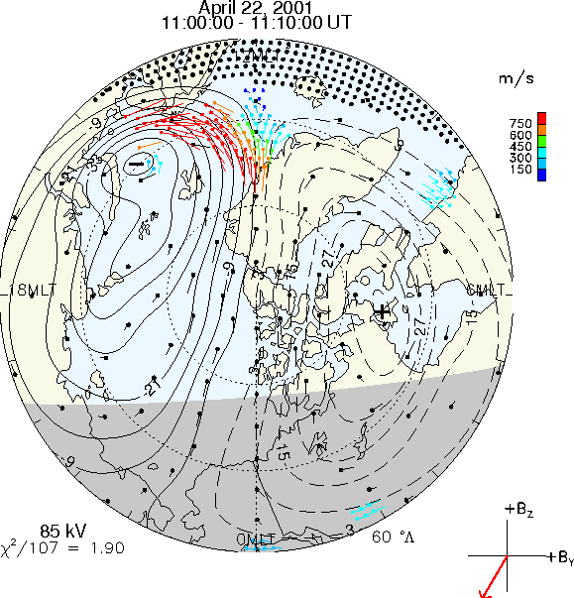
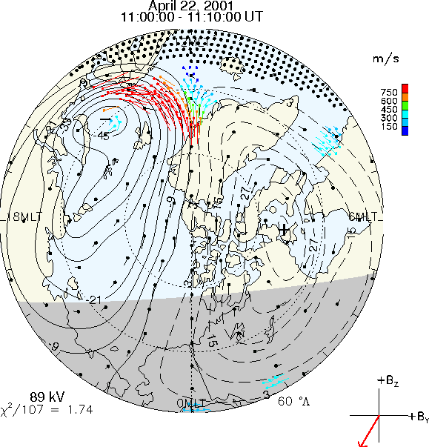
Model Data Weighting
Org. Weighting
North
April 22, 2001
11:00 – 11:10 UT
New Weighting
89 kV
χ²/107=1.74
Model vector errors:
Original: dependent on order of fit and on average of data errors
New: Original value, scaled by number of data vectors in vicinity

Slide 12
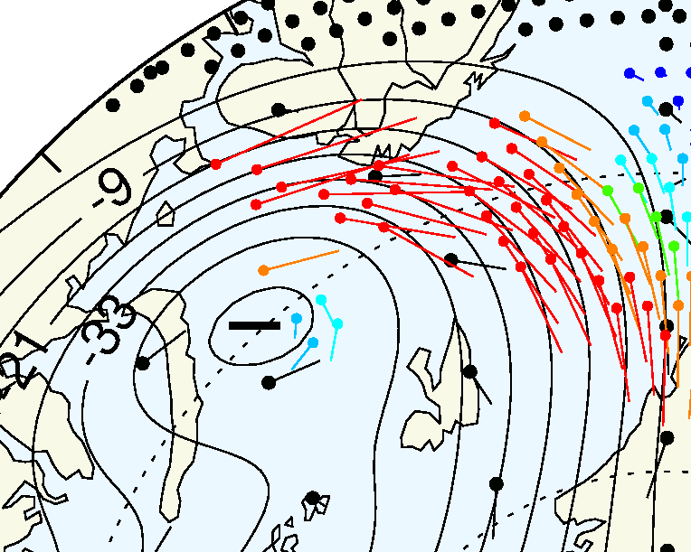
Model Data Weighting
Org. Weighting
North
April 22, 2001
11:00 – 11:10 UT
New Weighting

Slide 13
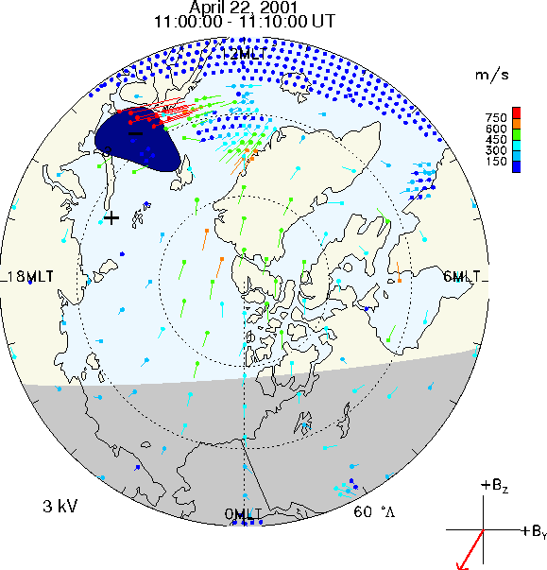
Model Data Weighting
Org. Weighting
North
April 22, 2001
11:00 – 11:10 UT
New Weighting
Difference
89 kV
χ²/107=1.74
Average Difference over 24 hours < 1%
4%

Slide 14
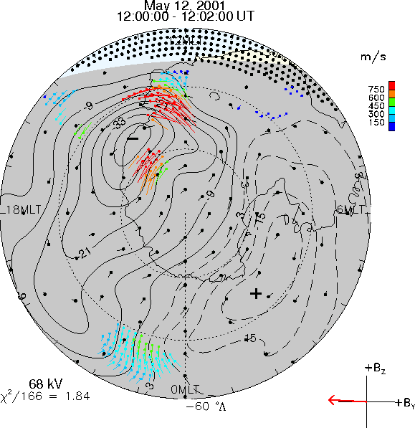
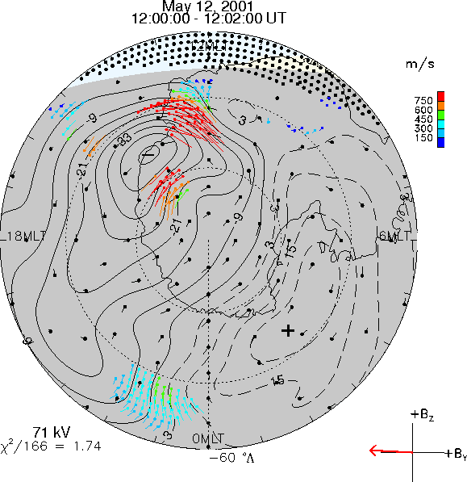
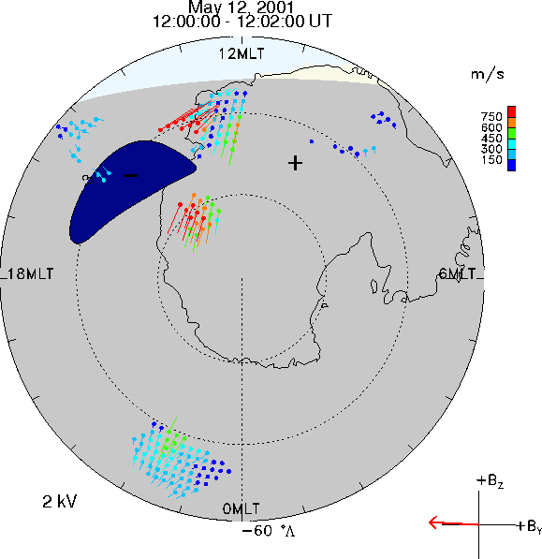
Model Data Weighting
Org. Weighting
South
May 12, 2001
12:00 – 12:02 UT
New Weighting
Difference
71 kV
χ²/166=1.74
Average Difference over 24 hours ≈ 1%
3%

Slide 15
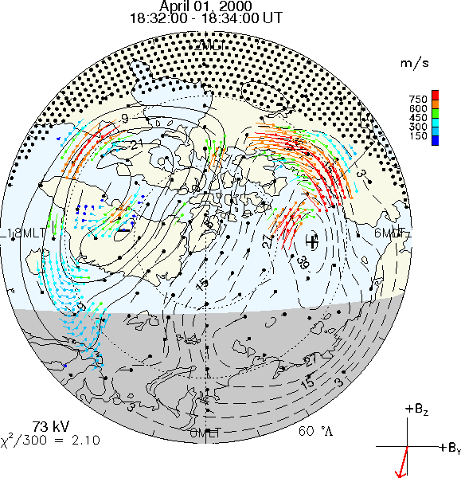
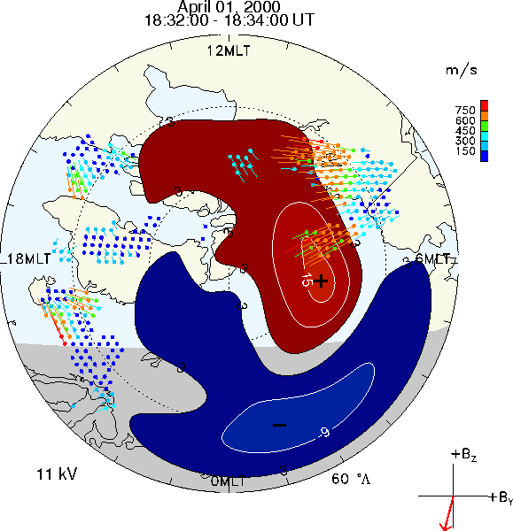
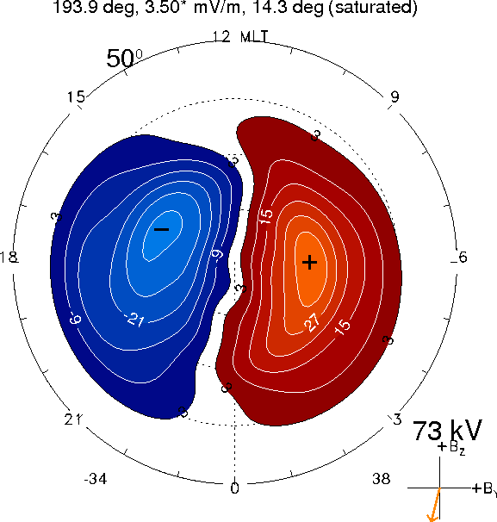
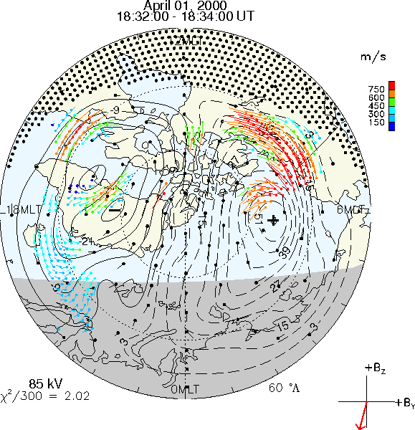
Statistical Model
RG96 model
Fit w/ RG96
North
April 01, 2000
18:32 – 18:34 UT
Difference
68 kV
CS10 model
Fit w/ CS10
15%
Average Difference over 72 hours ≈ 1%
(≈ 3% in summer
≈ -7% in winter)
-34
38
Notes:
Diff between models is mostly tilt effect. Newmod w/ same IMF, slightly neg til: -39, 33kV.

Slide 16
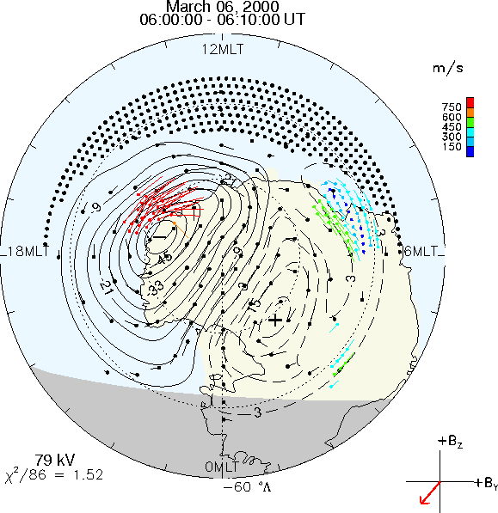
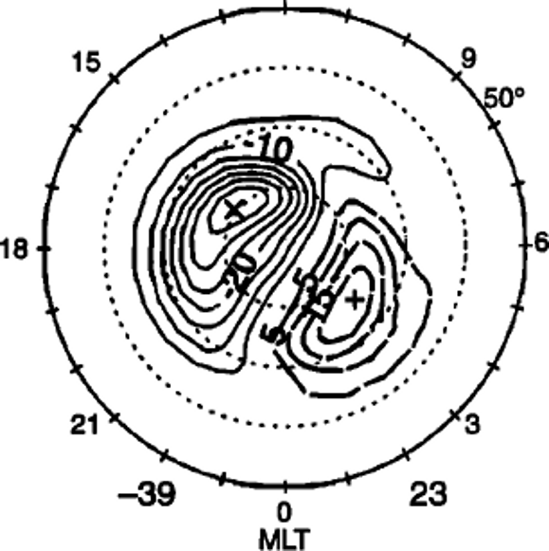
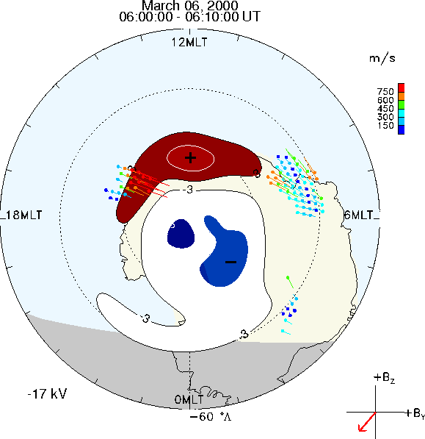
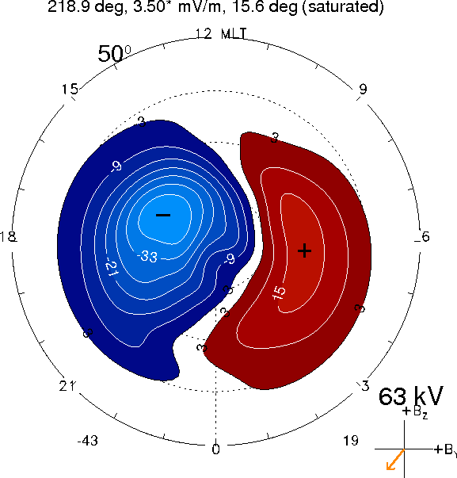
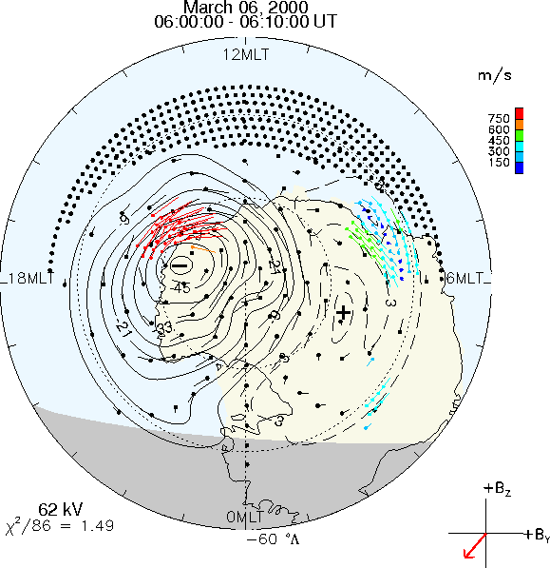
Statistical Model
RG96 model
Fit w/ RG96
South
March 06, 2000
06:00 – 06:10 UT
Difference
62 kV
CS10 model
Fit w/ CS10
-22%
Average Difference over 72 hours ≈ -12%
(≈ -7% in summer
≈ -9% in winter)
-43
19
Notes:
Diff between models is mostly tilt effect. Newmod w/ same IMF, slightly neg til: -37, 27kV. Similar cell orientation/shape

Slide 17
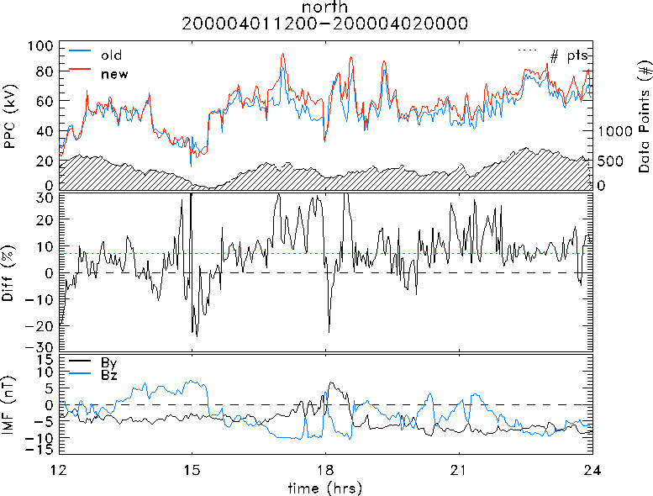
Total Difference

Slide 18
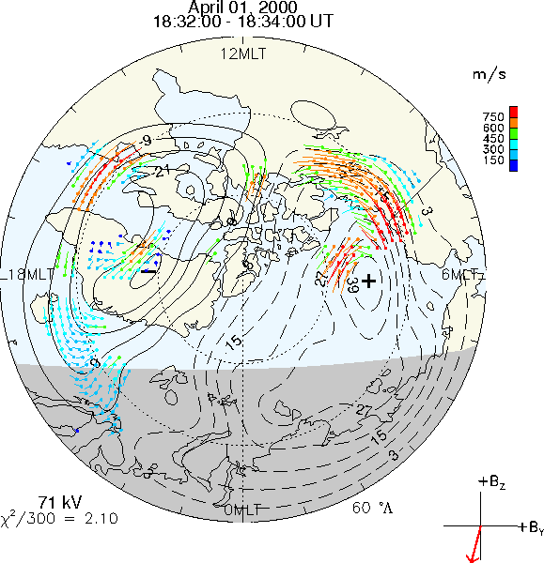
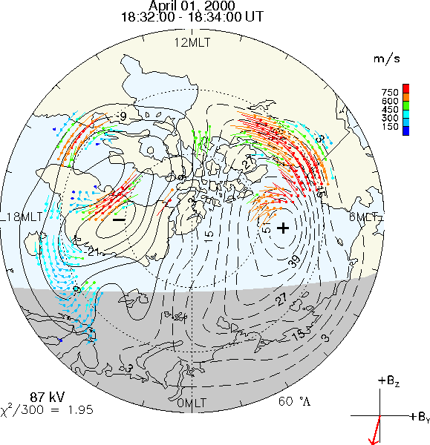
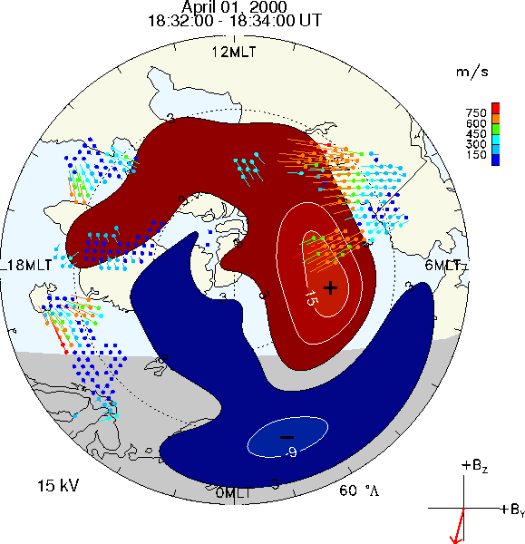
Total Difference
Original
North
April 01, 2000
18:32 – 18:34 UT
New
Difference
87 kV
χ²/300=1.95
By = -2.6 nT
Bz = -10.7 nT
Average Difference over 72 hours ≈ 3%
Diff due to new model:
11 kV
15%
21%
Notes:
Just changing model: 11 kV, 15%

Slide 19
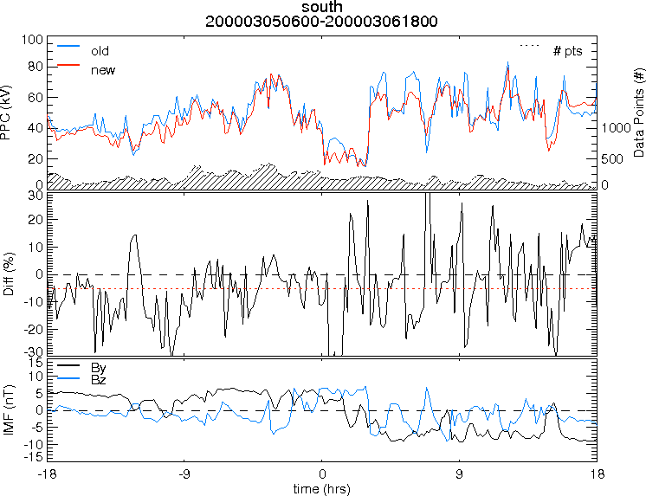
Total Difference

Slide 20
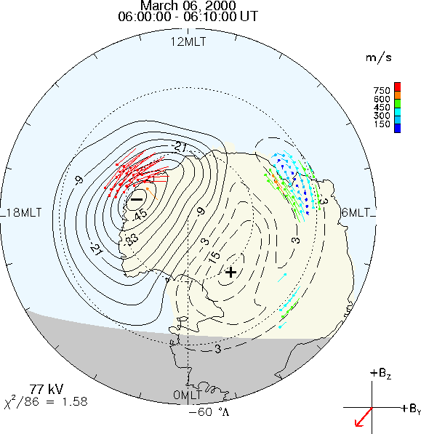
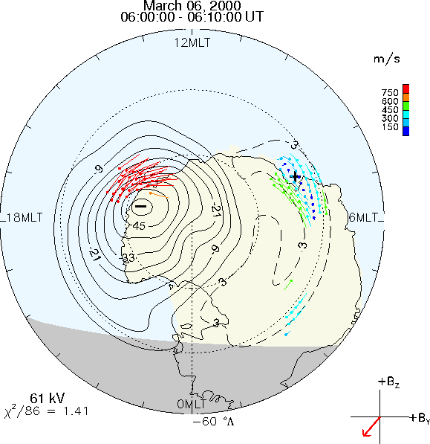
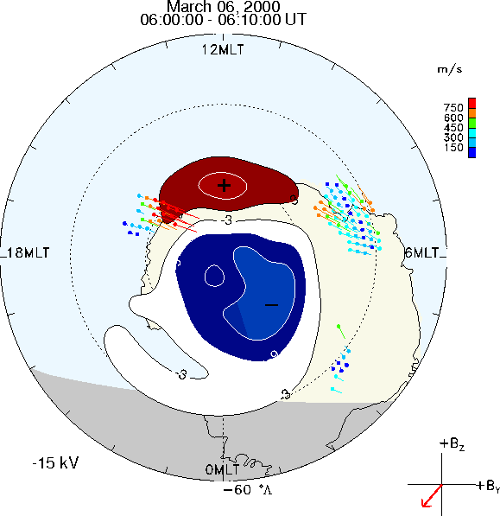
Total Difference
Original
South
March 06, 2000
06:00 – 06:10 UT
New
Difference
61 kV
χ²/86=1.41
By = -5.7 nT
Bz = -7.1 nT
Average Difference over 72 hours ≈ -8%
Diff due to new model:
-17 kV
-22%
-20%
Notes:
Just changing model: -17, -22%

Slide 21
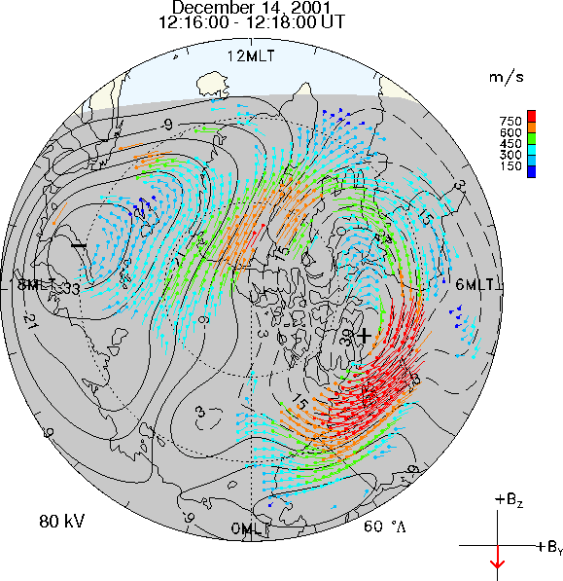
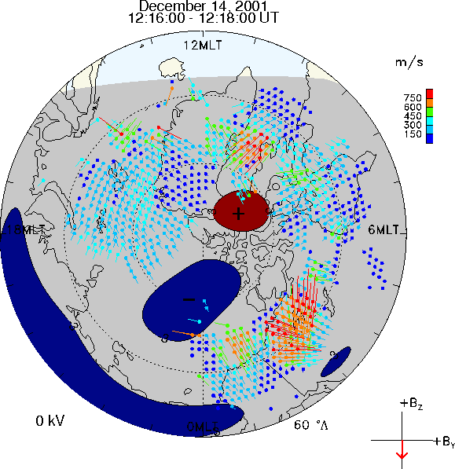
Total Difference
New
Difference
By, Bz = 0, -6.2 nT
Often little or no difference when data coverage is excellent

Slide 22


Total Difference
-2.2 %
-2.7 %

Slide 23


Total Difference
2.0 %
-4.3 %

Slide 24


Total Difference
5.9 %
-3.0 %

Slide 25
Summary
Magnetic Field Model: Dipole → IGRF
Statistical data error weighting: Uniform → Variable
Statistical Model: RG96 → CS10

Slide 26
Summary
Magnetic Field Model: Dipole → IGRF
Statistical data error weighting: Uniform → Variable
Statistical Model: RG96 → CS10
Small (0 – 10%) average offset between new & old Φ_{PC}
RMS difference between patterns is typically
  2-4 kV in North, 6-8 kV in South (mostly due to new model)
Up to 20 – 30% change in individual patterns’ Φ_{PC} with moderate to low data coverage

Slide 27
Summary
Magnetic Field Model: Dipole → IGRF
Statistical data error weighting: Uniform → Variable
Statistical Model: RG96 → CS10
Small (0 – 10%) average offset between new & old Φ_{PC}
RMS difference between patterns is typically
  2-4 kV in North, 6-8 kV in South (mostly due to new model)
Up to 20 – 30% change in individual patterns’ Φ_{PC} with moderate to low data coverage
Still needed: get IMF data from OMNI
  More robust time shifting

